Slide 1
QOS TRIAL TESTING OF MOBILE FINANCIAL SERVICES (MFS) - CASE OF GHANA
BY
Samuel K. Agyekum,
(Dep. Manager, NCA & Vice Chairman, ITU-T SG 12 AFR)

Slide 2
Outline
Presentation Outline
Introduction
Test Methodology
Measurement Profile & Scenario
QoS Parameters, Definitions & Formula
Test Results and Analysis
Conclusion & Way Forward

Slide 3
Outline
Introduction
The National Communications Authority (NCA) conducted a QoS trial testing exercise on mobile financial services from 12th June 2019 at 10:21 am to 27th June 2019 at 01:24pm.
The test was performed with the objective of assessing the capability levels of mobile money platforms to comply with expected QoS targets on Digital Financial Services (DFS).
It also sought to reinforce the consumer protection readiness of the Authority on mobile money transaction services and more so in line with the Payment Systems and Services Act, 2019 (Act 987)

Slide 4
Outline
Test Methodology
National Communications Authority (NCA) is currently using the SIGOS Integrated Test Environment (SITE) system as its the billing verification solution on billing accuracy and revenue assurance tests.
In this QoS trial testing exercise on MFS;
A total of four (4) mobile money registered simcards for two (2) operators were fully configured to work in a complete, automated and independent way based on the Unstructured Supplementary Service Data (USSD) application.
Test CDRs of MOMO transactions were generated together with their configured settings.
Live CDRs were imported from Operators via the ftp link ftps://ftp@nca.org.gh.
Comparison of results was performed using live and test CDRs (from SITE system)

Slide 5
Outline
Measurement Profile & Scenario
Step 1:The test is initiated with the “Start Recording activity” after which the Measurement Sequence Activities follows.
Step 2: MFS Portal short code (USSD) of the operator is dialed by the sending number, herein “A-party”, as configured in the system.
Step 3: Money is transferred by the sending number to a receiving number, herein “B-party”.
Step 4: After the end of each transaction, the system becomes idle for 60 seconds (wait period) and reactivated to perform the next transaction.
NB: The “wait time” allows for the proper ending of the transaction and release of channels used for the transactions.

Slide 6
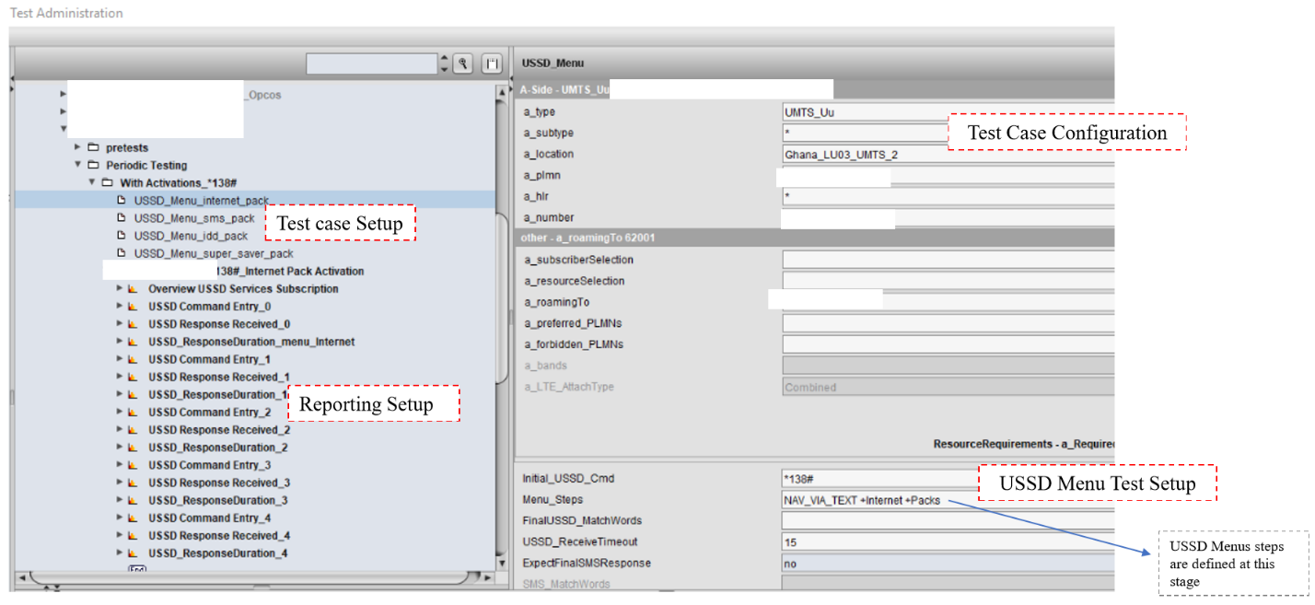
Outline
Measurement Profile & Scenario
Fig 1: Configuration of USSD services using the BVS for Momo Testing

Slide 7
Outline
QoS Parameters, Definitions & Formula
Parameter | Definition | Formula | Measurement Mechanism | Measurement Tool | Target
MFS Accessibility Rate | The percentage of successfully accessed MFS portal request | (Number of request response received/Total Request Attempts)*100 | Test Traffic | Billing Verification System | =100%
MFS Response Time | The duration from when a request is made to when response is received | Average Response Duration for each USSD Command String | Test Traffic | Billing Verification System | All service requests less than 5 seconds
MFS Success Rate | The Percentage of successfully completed MFS request | (Number of completed service request/ Total number of service request) *100 | Test Traffic | Billing Verification System | =100%

Slide 8
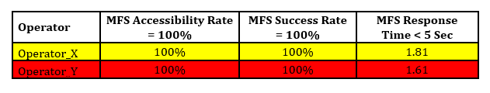
Outline
Test Results and Analysis
The parameters being assessed were benchmarked against related compliance requirements in draft QoS regulations, 2019.
The summary of the results of the QoS parameters under consideration for Operators X and Y are below:

Slide 9
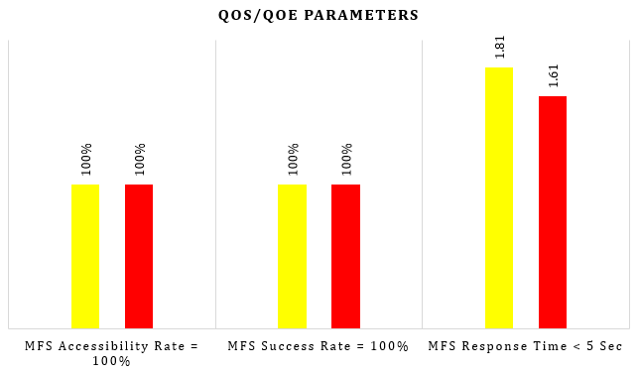
Outline
Test Results and Analysis
Fig 2a: Benchmarking the QoS performances of Operators X and Y
REMARKS:
Operators X and Y met the expected targets for all parameters tested (Accessibility Rate, Success Rate and Response Time).
Operators X and Y attained 100% in Accessibility Rate and Success Rate and recorded average service response times of 1.81 secs and 1.61 secs respectively

Slide 10
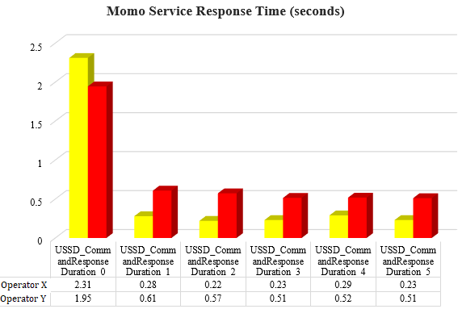
Outline
Test Results and Analysis
Fig 2b: Benchmarking the QoS performances of Operators X and Y
REMARKS:
Operators X and Y recorded less Response Times for all USSD requests with the exception of the Main Menu request command.

Slide 11
Conclusion & Way Forward
The findings of this exercise indicated that out of the 26 test cases, Operators X and Y recorded a Service Accessibility Rate of 100%, and Service Success Rate of 100% and Average Service Response times of 1.81 & 1.61 seconds respectively .
The Authority would review the test methodology report of the Security, Infrastructure and Trust (SIT) Working Group under ITU’s Financial Inclusion Global Initiative (FIGI) program to inform future trials and campaigns.
The test reports would be shared with SG 12 as Ghana’s contribution to the ongoing DFS standardization work under Q13/12 ahead of next ITU-T SG 12 meeting.

Slide 12

Thank You for your time & attention

